Slide 1

Session 8
Cyber Attacks - DNS Attacks & DDoS

Slide 2

Learning Outcomes :
By the end of this session, you will:
Identify and describe DNS attacks and Distributed Denial of Service (DDoS) attacks.
Understand the technical mechanisms behind DNS and DDoS attacks.
Explore the impacts of these attacks on systems and networks.
Learn about strategies and tools for defense against DNS and DDoS attacks.

Slide 3

Understand :
What Is DNS and Why Is It Important?
What Are DNS Attacks?
Definition, types, and real-world examples.
What Is a DDoS Attack?
Overview, techniques, and consequences.
Mechanics of DNS and DDoS Attacks
Defensive Strategies Against DNS and DDoS Attacks

Slide 4
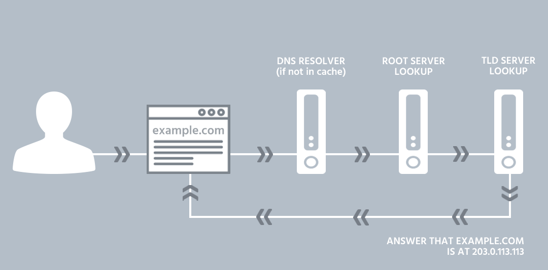
What Is DNS ?
Domain Name System (DNS):
Converts human-readable domain names (e.g., www.example.com) into machine-readable IP addresses (e.g., 192.168.1.1).
A critical component of internet infrastructure that ensures smooth access to online resources.
How It Works:
User types a domain name into a browser.
DNS resolves the domain name to its IP address.
The browser uses the IP address to retrieve the website.

Slide 5
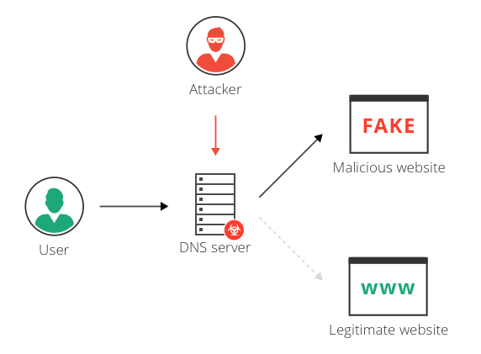
What Are DNS Attacks ?
DNS Attacks: Exploit vulnerabilities in the DNS infrastructure to disrupt services or compromise data.
Key Objectives of Attackers:
Redirect users to malicious websites to steal sensitive information.
Overload DNS servers, causing service outages.
Exploit DNS for other attack types, such as DDoS.

Slide 6

Types of DNS Attacks
DNS Spoofing (Cache Poisoning):
Alters DNS records, redirecting users to fraudulent websites without their knowledge.
Example: User tries to visit a banking site but is redirected to a fake site that steals login credentials.
DNS Tunneling:
Encodes data into DNS queries to bypass firewalls or extract data.
Often used for covert communication or data exfiltration.
DNS Amplification:
A type of DDoS attack where attackers send small queries to DNS servers, causing them to generate large responses, overwhelming the target.

Slide 7
Real-World DNS Attack Example
Mirai Botnet Attack (2016):
Targeted Dyn, a major DNS service provider, using a DNS-based DDoS attack.
Resulted in outages for major websites like Twitter, Netflix, and Reddit.
Impact: Highlighted vulnerabilities in IoT devices that were exploited to create a massive botnet.

Slide 8
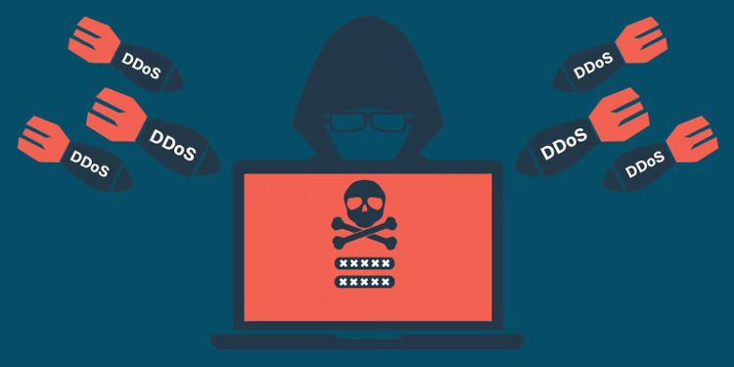
What Is a DDoS Attack ?
Distributed Denial of Service (DDoS):
An attack that overwhelms a target server, network, or website with excessive traffic, rendering it unavailable.
Characteristics:
Uses multiple compromised devices, known as a botnet.
Traffic can come from thousands or millions of infected devices worldwide.
Often targets high-profile organizations or services.

Slide 9
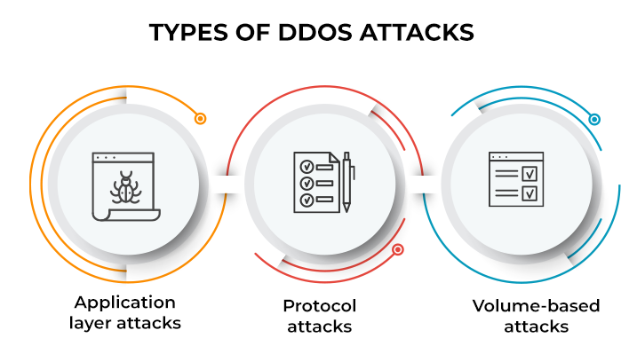
Types of DDoS Attacks
Volume-Based Attacks:
Flood the target with massive amounts of traffic.
Example: UDP floods, ICMP floods.
Protocol Attacks:
Exploit weaknesses in protocols like TCP, SYN, or HTTP.
Example: SYN flood attacks overload server connections.
Application Layer Attacks:
Target specific applications, such as a website’s login page.
Example: HTTP GET/POST floods.

Slide 10
How DDoS Attacks Work
Botnet Creation
Attackers infect multiple devices with malware to create a network of bots.
1
Command and Control (C&C)
Bots receive instructions from a central server controlled by the attacker.
2
Attack Execution
Bots flood the target server or network with requests or data, causing it to crash.
3

Slide 11
Impacts of DNS and DDoS Attacks
Service Downtime
Websites, apps, and services become inaccessible
Increased Costs
Financial Losses
Recovery and mitigation can be expensive
Loss of revenue due to downtime or theft
Reputation Damage
Customers lose trust in the organization

Slide 12
Defensive Strategies Against DNS Attacks
Use DNSSEC (DNS Security Extensions):
Adds a layer of authentication to DNS queries.
Regularly Monitor DNS Traffic:
Detect and block suspicious patterns early.
Harden DNS Servers:
Apply security patches and reduce exposure.
Limit Recursive Queries:
Prevent misuse by unauthorized users.

Slide 13
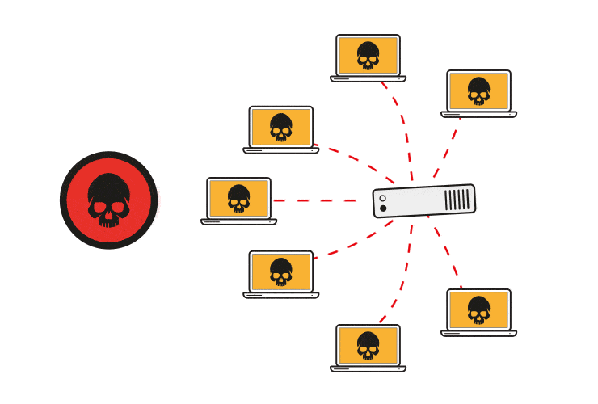
Defensive Strategies Against DDoS Attacks
Implement Traffic Filtering:
Block malicious traffic at firewalls or routers.
Use Load Balancers:
Distribute traffic across multiple servers to prevent overload.
Deploy DDoS Protection Tools:
Services like Cloudflare or Akamai mitigate attacks.
Network Redundancy:
Use geographically dispersed servers to absorb traffic.

Slide 14


PYTHON PRACTICAL ACTIVITY ( Code Link )
Practical Activity # 1 (DNS Spoofing Simulation)
Practical Activity # 2 (DNS Tunneling Simulator (Covert Data Transmission))
Practical Activity # 3 (DDoS Traffic Simulator)
Practical Activity # 4 (DNS Resolver with Spoof Detection)
Practical Activity # 5 (Volume-Based DDoS Detector (Threshold Alerting))

Slide 15
Practical Activity # 1 (DNS Spoofing Simulation)
🔐 Demonstrates how DNS spoofing (cache poisoning) redirects users to fraudulent IP addresses.
def dns_spoof_sim(domain):
fake_dns = {
"www.bank.com": "192.0.2.66", # Malicious IP
"www.mail.com": "203.0.113.1"
}
real_dns = {
"www.bank.com": "142.251.32.110",
"www.mail.com": "172.217.11.101"
}
spoofed_ip = fake_dns.get(domain)
original_ip = real_dns.get(domain)
print(f"🌐 Domain: {domain}")
print(f"🛡️ Legitimate IP: {original_ip}")
print(f"⚠️ Spoofed IP Redirect: {spoofed_ip}")
print("🚨 You have been redirected! Possible DNS Spoofing attack!")
dns_spoof_sim("www.bank.com")

Slide 16
Practical Activity # 2 (DNS Tunneling Simulator (Covert Data Transmission))
🔐 Demonstrates how attackers encode sensitive data within DNS queries to bypass firewalls undetected.
def dns_tunneling_sim(data):
print("📡 Simulating DNS tunneling of data...")
encoded_data = '.'.join(format(ord(char), 'x') for char in data)
dns_query = f"{encoded_data}.malicious-domain.com"
print(f"🚨 Encoded Data in DNS Query: {dns_query}")
dns_tunneling_sim("topsecret")

Slide 17
Practical Activity # 3 (DDoS Traffic Simulator)
🔐 Demonstrates how multiple fake requests from random IPs can simulate a Distributed Denial of Service (DDoS) attack.
import random
import time
def simulate_ddos_attack(target, duration=5):
print(f"🧨 Starting DDoS simulation on {target}...\n")
end_time = time.time() + duration
request_count = 0
while time.time() < end_time:
fake_ip = f"{random.randint(1,255)}.{random.randint(0,255)}.{random.randint(0,255)}.{random.randint(0,255)}"
print(f"🔁 Request from {fake_ip} → {target}")
request_count += 1
time.sleep(0.2)
print(f"\n🔥 DDoS Simulation Ended: {request_count} requests sent in {duration} seconds.")
simulate_ddos_attack("www.victimsite.com", duration=3)

Slide 18
Practical Activity # 4 (DNS Resolver with Spoof Detection)
🔐 Demonstrates how spoof detection can identify mismatched DNS responses that may indicate an attack.
def resolve_with_spoof_check(domain, response_ip):
known_legit_dns = {
"example.com": "93.184.216.34",
"securebank.com": "104.244.42.65"
}
real_ip = known_legit_dns.get(domain)
if not real_ip:
print(f"🔎 No reference IP available for {domain}.")
return
if response_ip != real_ip:
print(f"🚨 WARNING: Spoofed response detected for {domain}!")
else:
print(f"✅ Safe: IP matches expected value for {domain}.")
resolve_with_spoof_check("securebank.com", "91.198.174.192")

Slide 19
Practical Activity # 5 (Volume-Based DDoS Detector (Threshold Alerting))
🔐 Demonstrates how analyzing traffic volume across time can help detect abnormal surges indicative of a DDoS attack.
def detect_volume_ddos(traffic_log):
threshold = 100
print("📊 Monitoring incoming request volume...\n")
for time_slot, request_count in traffic_log.items():
print(f"{time_slot}: {request_count} requests")
if request_count > threshold:
print("🚨 ALERT: Potential DDoS detected in this time slot!")
# Simulated traffic data
traffic = {
"12:00": 80,
"12:01": 110,
"12:02": 95,
"12:03": 130
}
detect_volume_ddos(traffic)

Slide 20


Exercise
1. What is the primary function of the Domain Name System (DNS)? A) Encrypt web traffic between users and servers B) Translate IP addresses into MAC addresses C) Convert domain names into IP addresses D) Manage SSL certificates for websites Answer: C
2. What is a common goal of a DNS spoofing (cache poisoning) attack? A) To disable a user’s device completely B) To redirect users to fraudulent websites C) To reduce network congestion D) To test server speed Answer: B

Slide 21
Exercise
3. In a DDoS attack, what is a botnet? A) A tool to detect malware in DNS requests B) A secure communication protocol for DNS C) A network of compromised devices used to flood a target D) A type of browser extension used for phishing Answer: C
4. Which of the following is a type of DDoS attack that targets web application functions? A) Protocol attack B) Volume-based attack C) Application layer attack D) DNS amplification attack Answer: C
5. What does DNSSEC help prevent? A) Data encryption failures B) DNS spoofing by adding authentication to DNS responses C) DDoS flooding by redirecting traffic D) Unauthorized access to encrypted files Answer: B

Slide 22
Future Trends in DNS and DDoS Defense
AI-Powered Detection: Machine learning for identifying patterns.
Blockchain-Based DNS: Decentralized DNS to reduce vulnerabilities.
Stronger Encryption Protocols: Securing communications.

Slide 23
Conclusion
Understanding DNS & DDoS Attacks
Threat Recognition: DNS and DDoS attacks are major threats to the stability and security of online services and infrastructure.
Attack Techniques: Attackers exploit DNS systems and overload networks to redirect traffic, steal data, or cause service disruptions.
Technical Awareness: Understanding the mechanics of these attacks—such as spoofing, tunneling, and volumetric floods—is crucial for defense.
Defense Measures: Proactive defense strategies, like DNSSEC, load balancers, and DDoS mitigation tools, are essential to reduce vulnerability.
Future Preparedness: Staying updated with trends, including AI-powered threat detection and decentralized DNS systems, enhances resilience.

